Slide 1








IT Problem Solving Adventures
Seas the Day!

Slide 2

Agenda
The Importance of Problem Solving
How to be an Awesome Solver of Problems
Choose Your Adventure Problem Solving
Make the World a Better Place

Slide 3

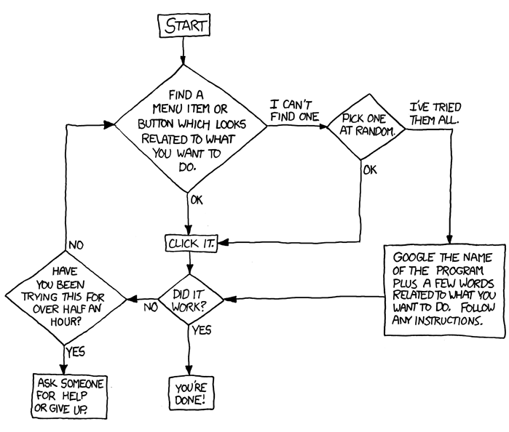
The Importance of Problem Solving

Slide 4




en· gi· neer· ing The practice of using natural science, mathematics, and the engineering design process to solve technical problems, increase efficiency and productivity, and improve systems.
We are faced with problems constantly that need solved, that’s the job. We need to have strategies to tackle them efficiently.
You can apply these strategies regardless off the problem, the technology, or your expertise.

Slide 5


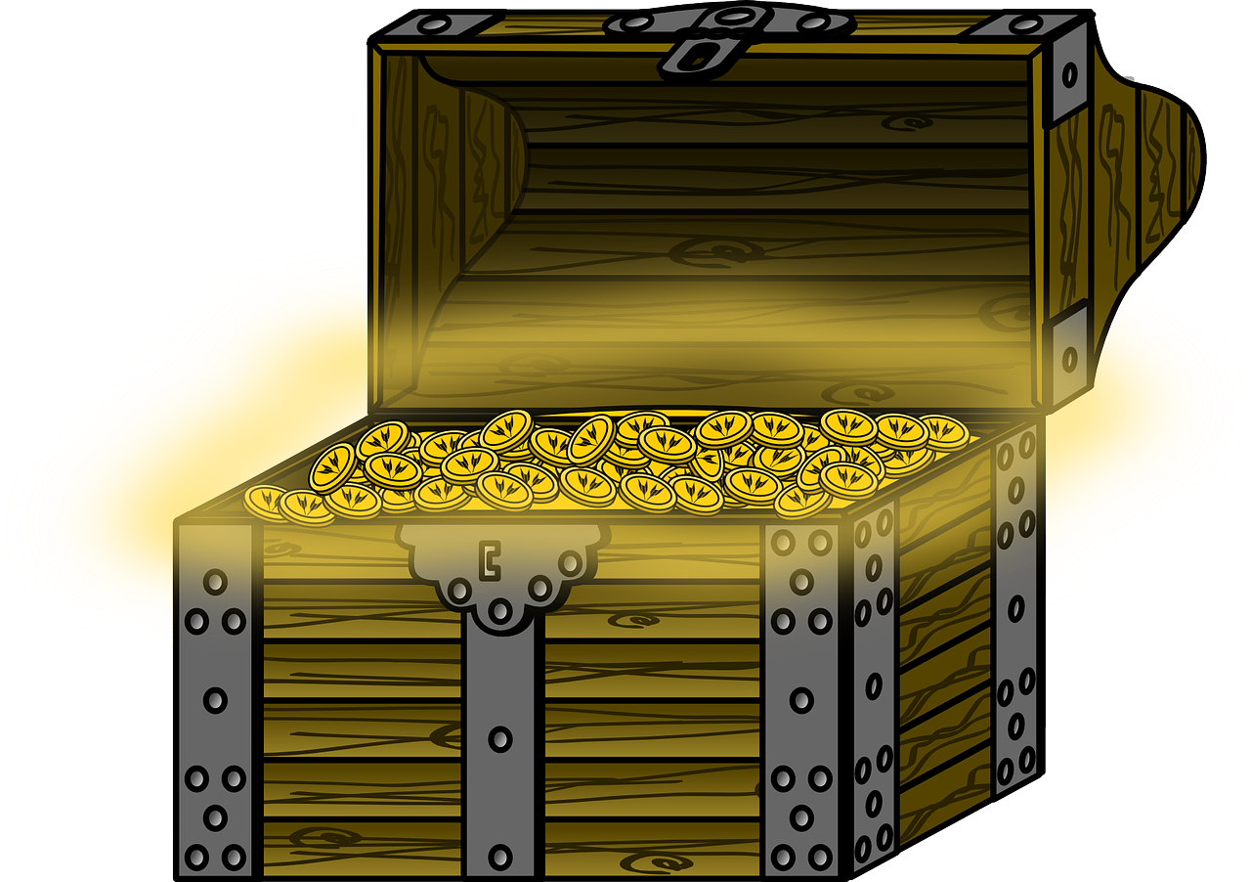
How to be an Awesome Solver of Problems

Slide 6

Trust No one Ever
Verify to build trust when analyzing problems
Intentions are always good, but mistakes happen
Gets everyone on the same page
This Photo by Unknown Author is licensed under CC BY-NC-ND
Notes:
Real world example, takes car into shop for maintenance, they ask the last time you had an oil change and the tires rotated. You say you just did that. They are still going check everything to make sure its good and verify things.
Maybe you thought topping off the windshield wiper fluid was changing the oil or you had just changed your spouses oil and not yours. Mistakes happen, verifying things helps everyone start out with the same trusted understanding.
Have you experienced this? Has someone told you something with certainty, but later you verified to be false

Slide 7

Example
We updated the configs for the database connection, but the application is still not connecting in the test environment!?!
Where did you update the configs?
Right here is the update, see everything is correct!
How does your application in your test environment read the file from your local?
It… well… I committed and usually another process recognizes that and synchs it to the test environment…
Did that happen? Can we see the updates in the environment?
Notes:
Walk through the process out loud and together to verify not only the person, but the processes and systems in place.
As we gain parity between local, test, and production we should start eliminating the “it works on my machine” mentality. It will work everywhere then; we just need to make sure we have everything in place.

Slide 8
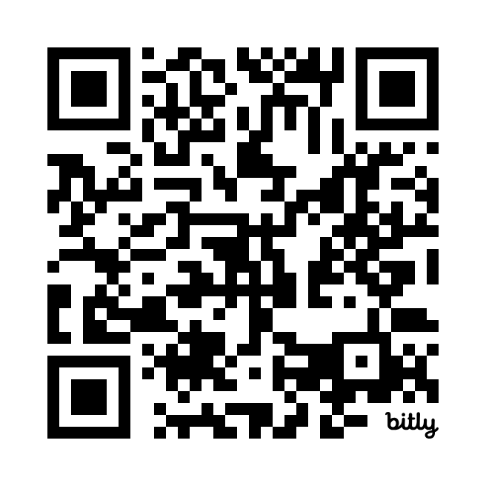
Problem #1 Consumer Error
https://bit.ly/ConsumerError

Slide 9

Questions Assumptions
When something breaks, we need to make sure assumptions line up with reality.
This Photo by Unknown Author is licensed under CC BY-SA
Notes:
Fuel gage in the car, you assume it works, but is there actually fuel in the tank

Slide 10



Example
Notes:
1. Boating and all the sudden the boat stops
2. The fuel gage reads full
3. You get it a mechanic and explain you were just humming along and all the sudden it stopped, you have no idea what’s going on as it full of gas.
3. The mechanic listens, however is experienced, and they first thing he does is check the simplest thing, something you assumed to be correct. Is there really gas?
4. Sure enough the tank is empty, it turns out your gage is broken and stuck reading full.
5. Alternatively he could have started tearing it apart looking for a problem, but we need to question assumptions and start simple.

Slide 11

Ask Questions!
Verbalize with others your understanding of the problem and the context that creates it. This gets everyone in alignment.
Ask questions to work towards a common understanding. This eliminates assumptions clears the path to a solution.
Scenario You are an engineer on a line and a quality engineer says the app is down. What are questions you would follow up with?
This Photo by Unknown Author is licensed under CC BY-SA
Notes:
Fresh eyes on a problem is a perfect opportunity to ask questions.
This often gives others a different point of view.
While explaining and bringing others up to speed this can trigger new thoughts/questions/solutions.
Think rubber duck debugging.

Slide 12

Seek to Understand
Steps to recreate issue
Context in which issue occurs
Recent changes applied
External impacts in play
Pro Tip: Explain the problem back, this gains alignment from everyone.
Notes:
This flows from asking questions, you ask question to seek to understand these areas.

Slide 13
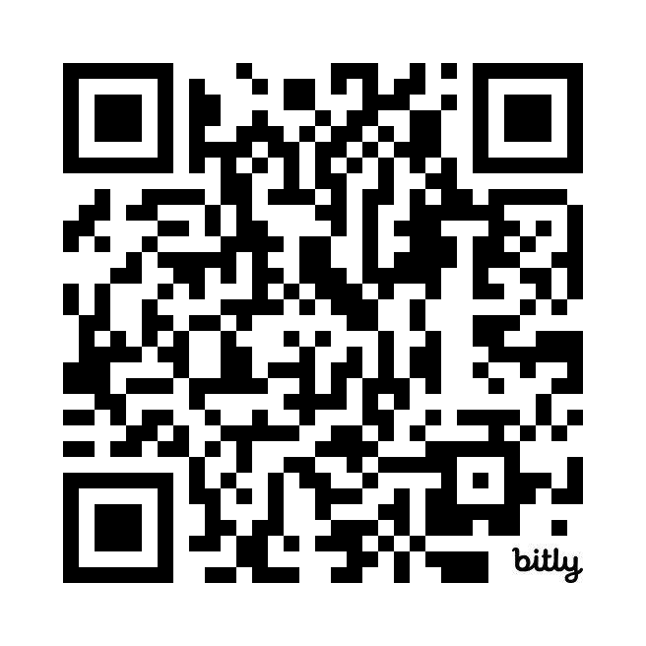
Problem #2 App Down!
Focus on asking questions
Explain CVE and the process of Twistlock
https://bit.ly/CMAppDown

Slide 14
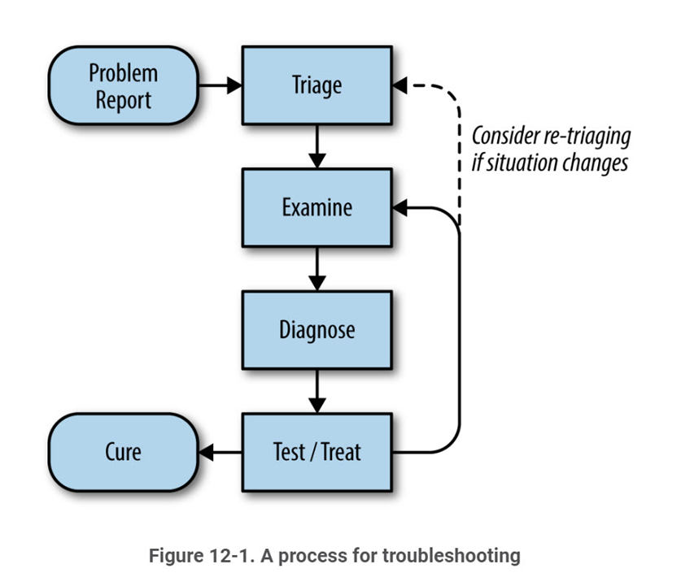
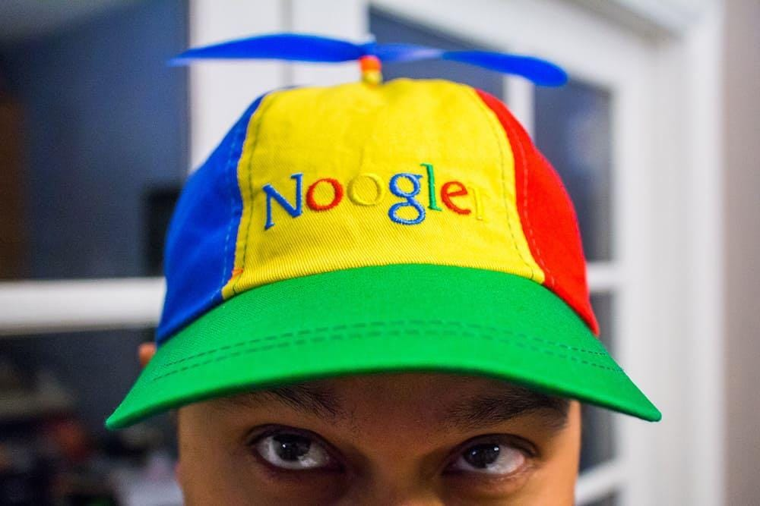
Strategy
https://sre.google/sre-book/effective-troubleshooting/
Notes:
Based upon medical practices, proven to work.

Slide 15

Prioritize for Impact
Customer Impacting (Production)
Immediate focus on restoring service
Monitoring & Analysis
Apply fix
Test & Observe
Little to No Customer Impact (Non-Production)
Monitoring & Analysis
Apply Fix
Test & Observe
Restore service
Notes:
Maybe start this by asking group what different priorities there might be between Prod and Test problems. SRE mentality, your first responsibility is to get the system working as well as you can if it is production.
Examples:
Rolling back the application version
Slow down traffic to the application
Failover to disaster recovery
Increase resources or workloads
Restart every pod/server

Slide 16
YAK Shaving – persevering processes/challenges
New scenario touching a point we haven’t in the others
Lower priority after updating CVE scenario

Slide 17
Start small & Simple
Isolate things and verify that they work as expected independently
Integration testing of things together we verified independently
Build things up until you find the problem, working towards the full “Onion”
Notes:
Start small and isolate, build up your case.
You have a ticket that the policy screen on the web app is not working. Front end web app that makes call through Apigee > Service Provider > DB
How would you approach this problem based on starting simple?

Slide 18
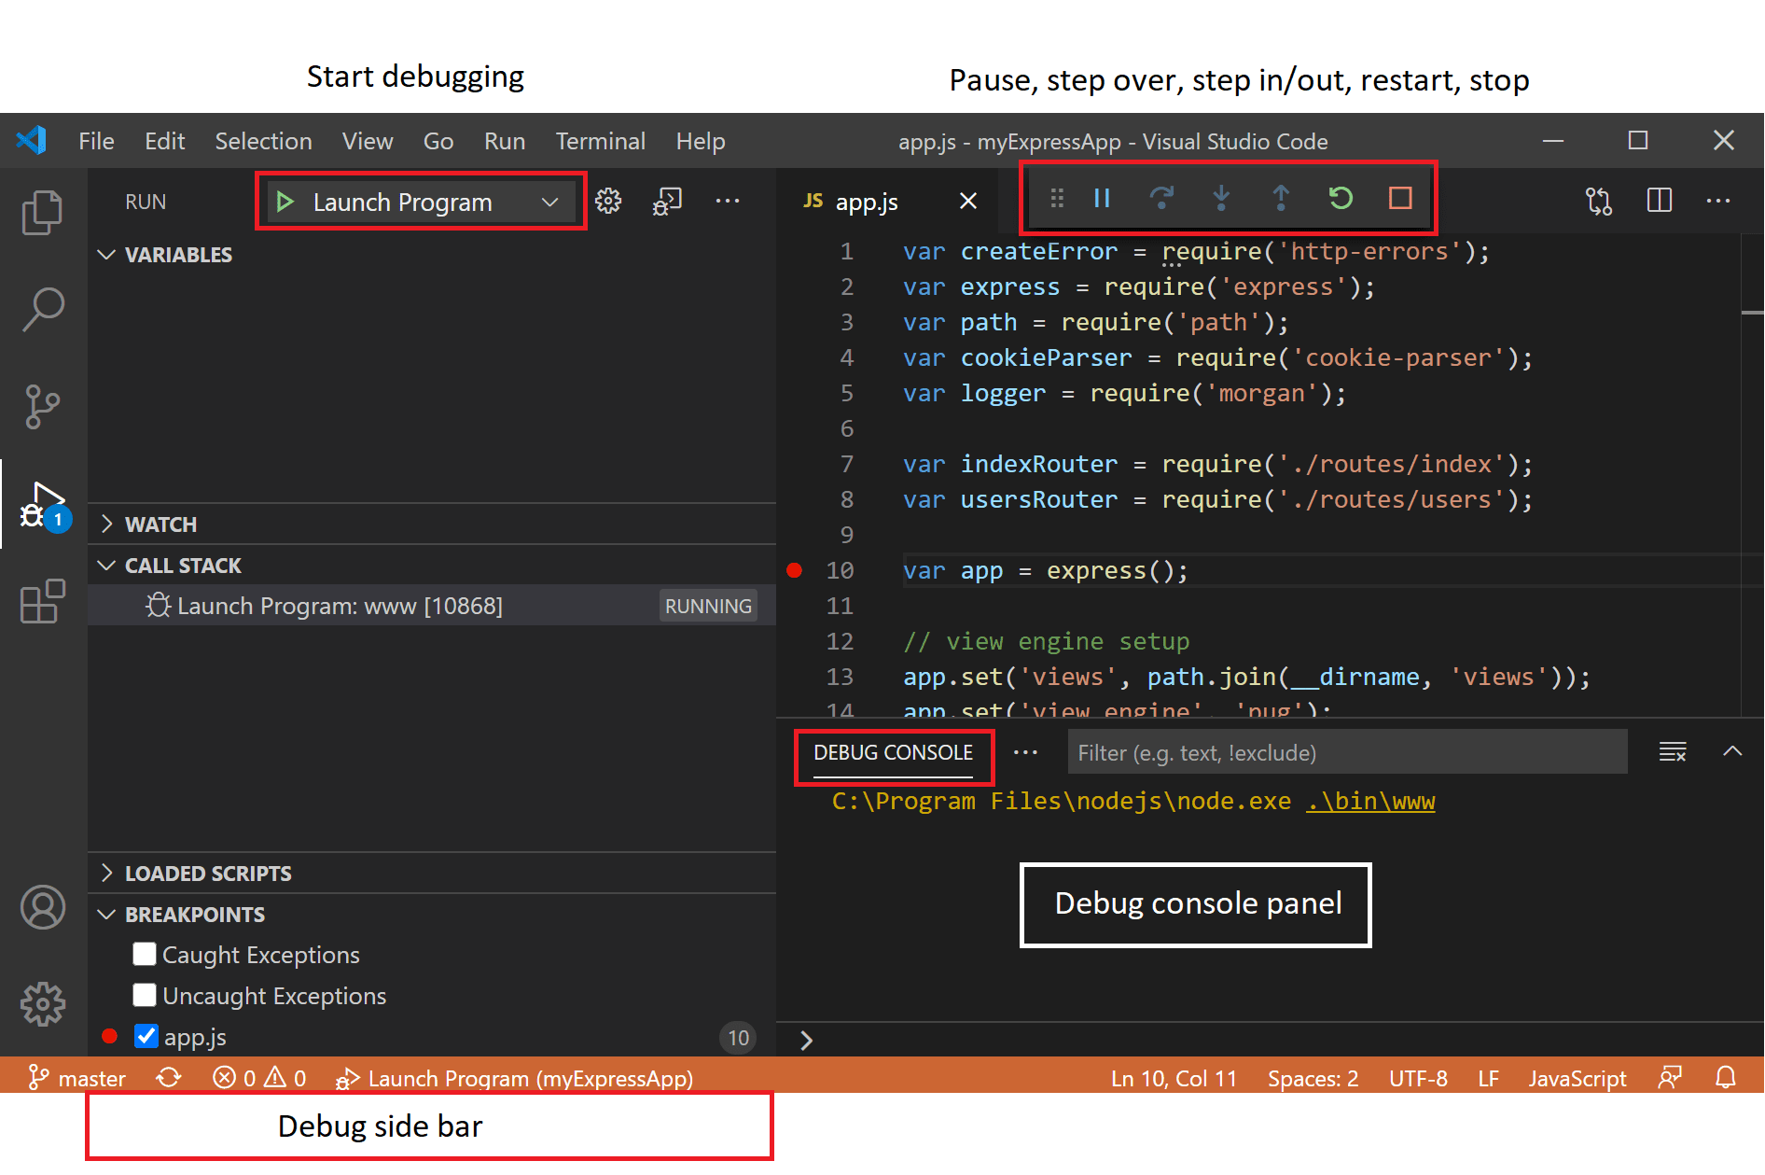
Local Running App Locally to Troubleshoot
Recreate and observe
Environment parity is critical
Greatest control here
Increase add logging
Debug and step through
Quick trial and error
Notes:
Start with why and when you would want to run locally?
Works best on logic and programmatic errors

Slide 19
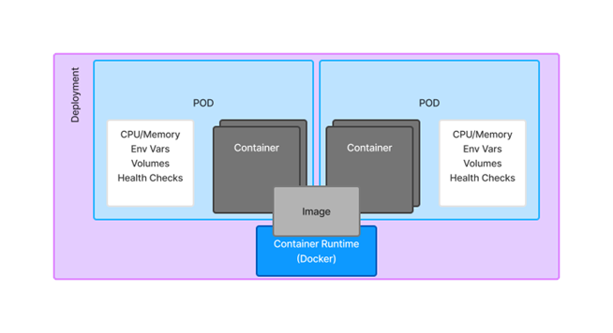
Deployed App Deployed in Test Environment Troubleshooting
Pods down?
Describe the pod and look at the events
Pod up?
ssh into pod to review logs or check files
Begin to validate each part of your deployment:
Notes:
What type of things can you do once deployed?
This helps if you can’t run the source code locally, which you ideally can.
Sometimes you can’t reproduce locally. Maybe there is something else in play such as a sidecar with IAM

Slide 20


External to you Consuming a service/Provider of a service
Dig before you call!
Gather relevant information before engaging another team
You have reached the end of your control
Be certain you have validated everything on your end
WARNIING
DIG BEFORE
YOU CALL
Disclaimer: not applicable when digging in the ground
Notes:
What kind of information would you like to have in order to start looking into an issue?
Diargrams

Slide 21
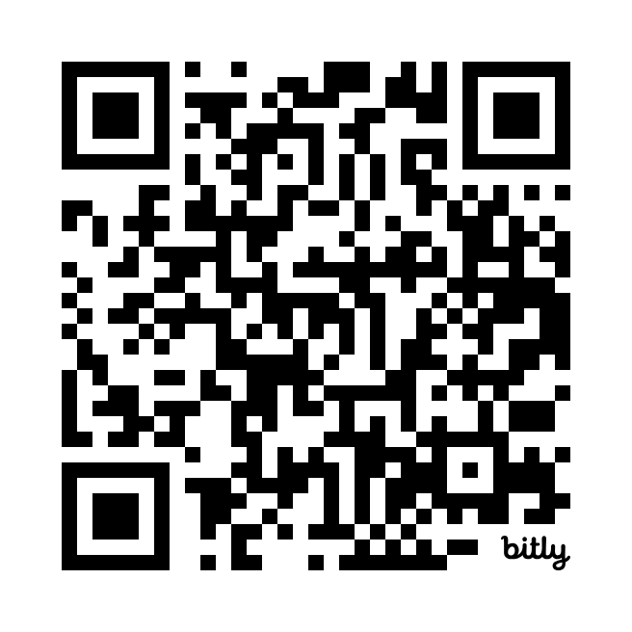
Kabloom! Nothing Works!
https://bit.ly/CMKabloom

Slide 22

Embrace the robot overlords
“Google” things that are not company specific
Understand how to use Gen AI to help
Search internal repos such as GitHub, SharePoint, and Custom Sites
Search communication platforms (RocketChat, Teams, Outlook, etc.)
This Photo by Unknown Author is licensed under CC BY-NC-ND
Notes:
GitHub Search Tips:

Slide 23
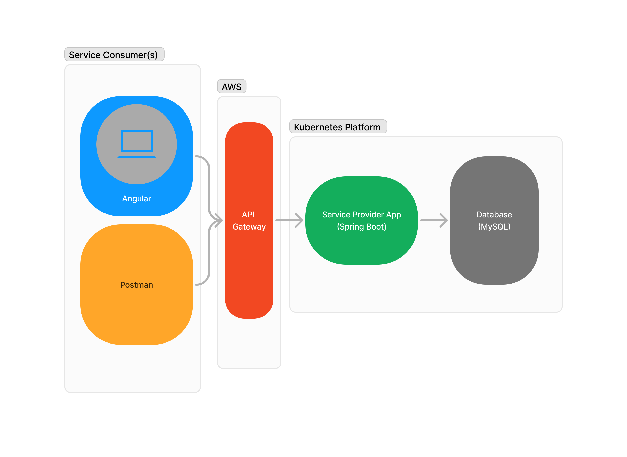

Try it yourself! Your Application Architecture
Start Here
Insert QR Code Here

Slide 24

Parting thoughts
“Be warned that being an expert is more than understanding how a system is supposed to work. Expertise is gained by investigating why a system doesn't work.”
Brian Redman
THANK YOU!
This Photo by Unknown Author is licensed under CC BY

